Slide 1
Ultimate Cycling Training System
The Ultimate Cycling Training System based on the power output measuring of the rider, which offers all cyclist real-time data they need to track their performances.
Notes:
- Aim: to build a power meter, which provides accurate and repeatable power readings. Furthermore a system with lower costs (economically affordable) and fully interchangeable, which allows communications with existing display devices and which can be mounted in a large range of bicycles.

Slide 2
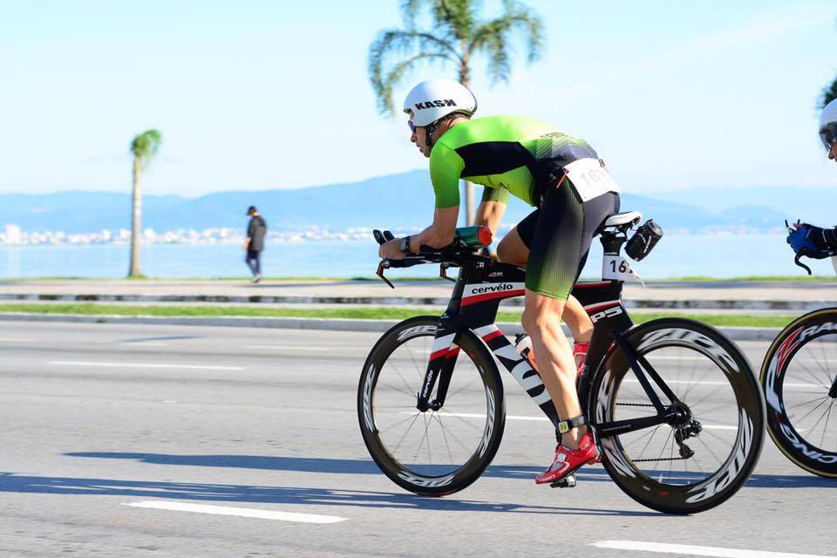
What is cycling power?
The power is the instantaneous output measurement of the power in Watts(W) produced by the rider
Motivation
Low interchangeability of the power meters available on the market.
High cost of the power meters available on the market.
Allows to train as efficiently as possible by providing a reliable metric to track cycling intensity.
Why training with power meter?
Power information provides residual fatigue information for past workouts, as well as when ones performs at his best
Allow the Train as efficiently as possible by providing a reliable metric to track cycling intensity.
.

Slide 3
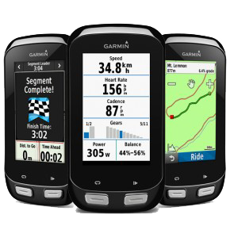
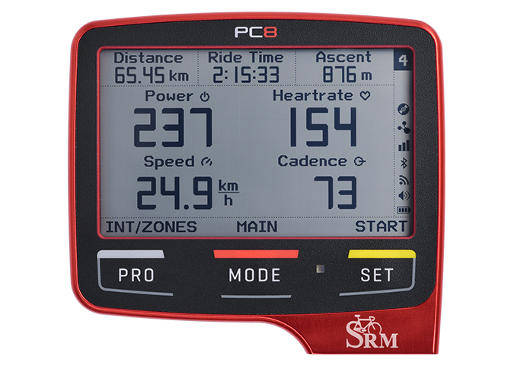
Cycling Data
Power Data
Additional Data
Power (Watts):
Current Power;
Average Power;
NP (Normalized Power);
IF (Intensity Factor);
Ride Distance (GPS System).
Ride Time.
Altitude (Elevation Gain):
Current Altitude;
Altitude Gain;
Heart Rate:
Current Heart Rate.
Average Heart Rate.
Cadence (Pedalling Frequency) .
Notes:
- NP (Normalized Power):
Normalized Power is calculated using an algorithm that is a little complex, but in a nutshell takes into account the variance between a steady workout and a fluctuating workout. The resulting value is an attempt to better quantify the physiological “cost” of the harder “feel” of the variable effort. For a highly variable workout, NP can be much higher than average power, where for a very steady workout, NP and average power are equivalent or very close together. A relatively high NP is showing that the workout had a lot of variation, and was harder physiologically than what average power may reveal.
IF (Intensity Factor):
Although normalized power is a better measure of training intensity than average power, it does not take into account differences in fitness within or between individuals. TrainingPeaks therefore also calculates an Intensity Factor (IF) for every workout or time range analyzed. IF is simply the ratio of the normalized power as described above to your threshold power. For example, if your normalized power for a long training ride done early in the year is 210 W and your threshold power at the time is 280 W, then the IF for that workout would be 0.75. However, if you did that same exact ride later in the year after your threshold power had risen to 300 W, then the IF would be lower, i.e., 0.70. IF therefore provides a valid and convenient way of comparing the relative intensity of a training session or race either within or between riders, taking into account changes or differences in threshold power.

Slide 4
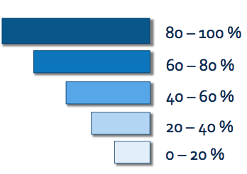
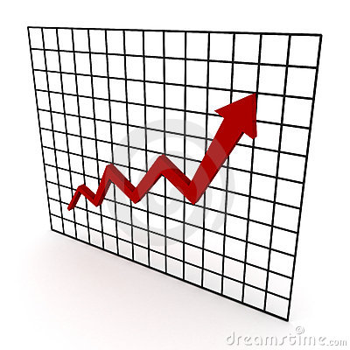

Graphical Display Alternatives
Graphical Scale
Plot
Notes:
- NP (Normalized Power):
Normalized Power is calculated using an algorithm that is a little complex, but in a nutshell takes into account the variance between a steady workout and a fluctuating workout. The resulting value is an attempt to better quantify the physiological “cost” of the harder “feel” of the variable effort. For a highly variable workout, NP can be much higher than average power, where for a very steady workout, NP and average power are equivalent or very close together. A relatively high NP is showing that the workout had a lot of variation, and was harder physiologically than what average power may reveal.
IF (Intensity Factor):
Although normalized power is a better measure of training intensity than average power, it does not take into account differences in fitness within or between individuals. TrainingPeaks therefore also calculates an Intensity Factor (IF) for every workout or time range analyzed. IF is simply the ratio of the normalized power as described above to your threshold power. For example, if your normalized power for a long training ride done early in the year is 210 W and your threshold power at the time is 280 W, then the IF for that workout would be 0.75. However, if you did that same exact ride later in the year after your threshold power had risen to 300 W, then the IF would be lower, i.e., 0.70. IF therefore provides a valid and convenient way of comparing the relative intensity of a training session or race either within or between riders, taking into account changes or differences in threshold power.

Slide 5
System schematic diagram

Slide 6
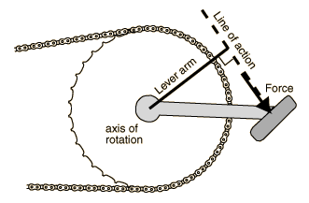
Power Measuring
Torque:
r is the arm lever;
F force applied on the pedals;
Power:
τ is the torque applied on the pedal;
w is the angular velocity, also called cadance (pedalling frequency).
Angular Velocity Sensor (Inclinometer and Cadence Sensors)
Power Assessment
Torque Sensor (Strain Gauges)

Slide 7
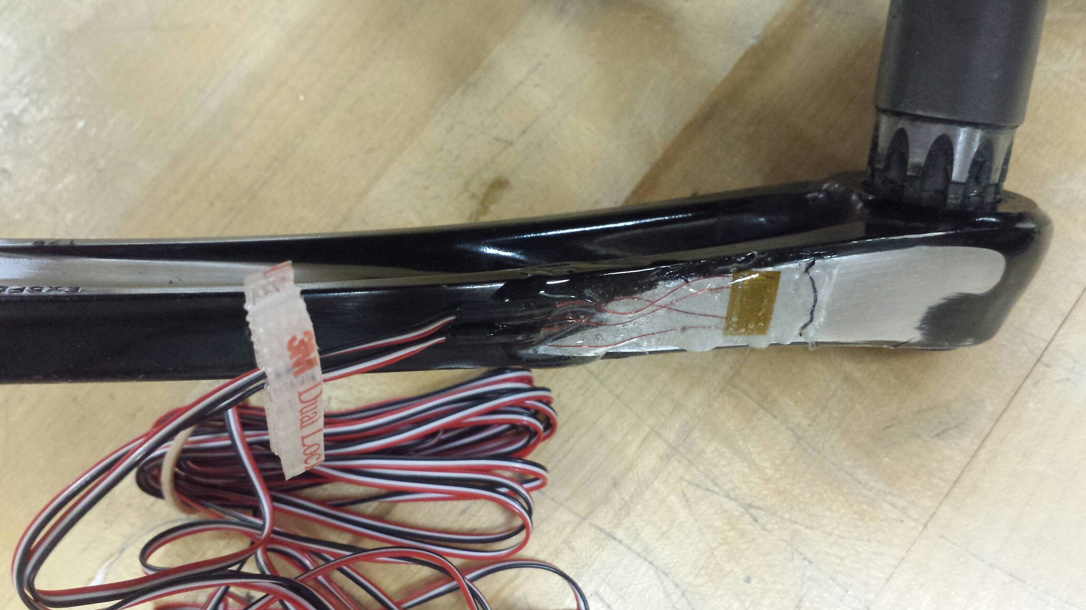
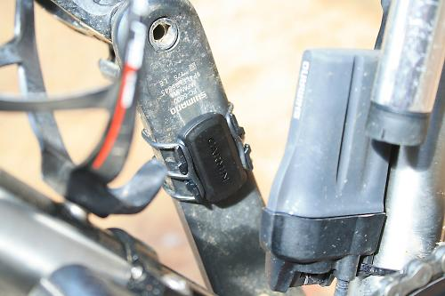
Sensor Examples

Slide 8
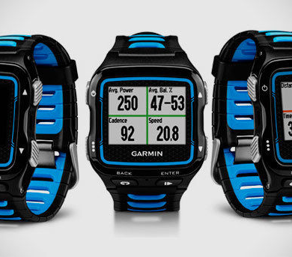

Display possibilities
Smart Watches
Smart Phones
Bike Displays
Notes:
Display Possibilities:
The display techniques that can be used in this project are
Smart watches (Garmin)
Smart phones
Garmin Smartwatches:
Garmin are the sport watches which helps the athletes (in this project) the cyclists to use the Global Positioning system(GPS). These watches are also designed to accurately measure distance, speed, heart rate , time, altitude, and pace, all of which can be important to athletes in training.
Smart Phones:
Smart phones possess the feature of bluetooth or WIFI facility which helps to link to the interface of the measuring device and display the results accurately on the display screen of the smart phone.

Slide 9
Project Milestones
1
Understanding the physics behind measuring power on a practical level. (Group Work)
2
Determining the connectivity protocol (ANT+, Bluetooth Low Power, etc.). (Muhammad)
3
Mounting the sensors on the bike. ( Youssef )
4
Setting the used wireless connectivity protocol.(Muhammad)
5
Data Display. (Karthika)
Data Acquisition and Processing (Microcontroller programming). (Pedro Baeta)
Acquired Data Management. (Pedro Baeta)
Deciding on the project electronic architecture. (Jorge Perez)
Final Tests. (Group Work)
Project Presentation. (Group Work).

Slide 10
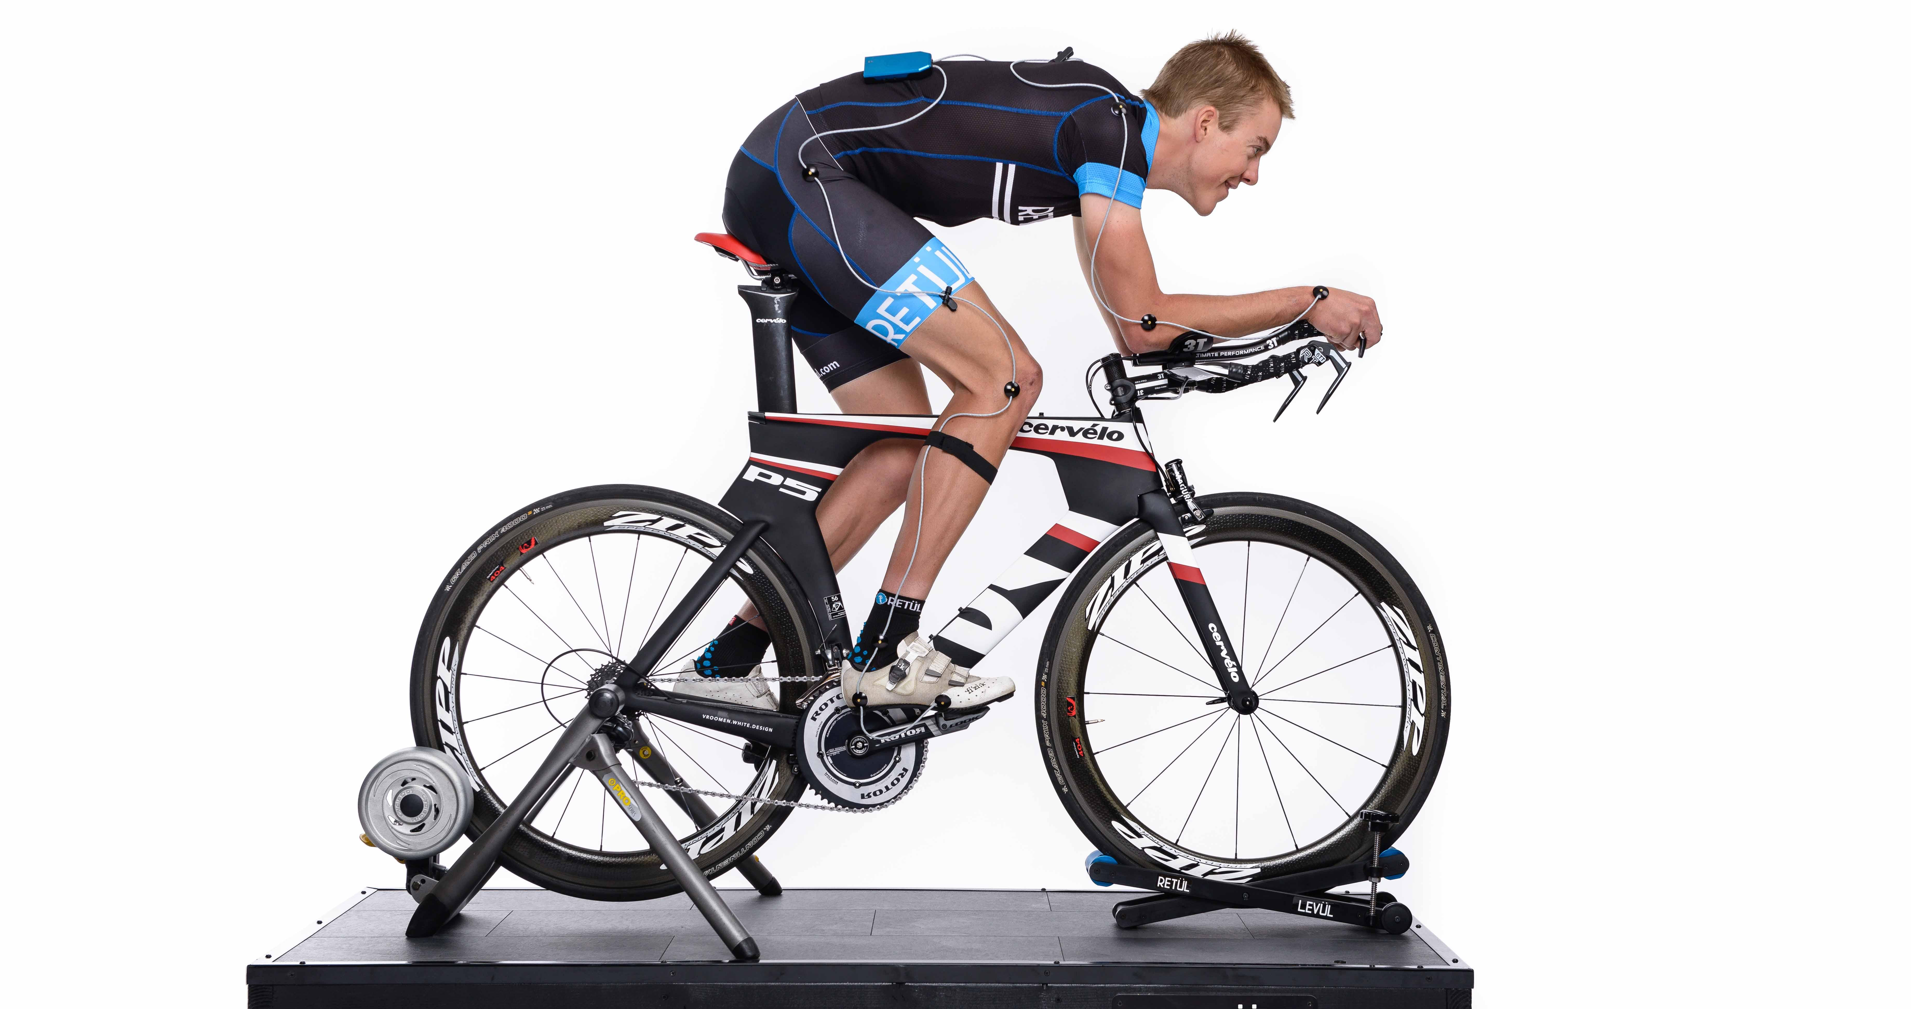
Project Presentation
Threshold Power Test
Volunteers
Display the information to the public.
Bicycle
Roller

